Slide 1

Console App
Bank Operations

Slide 2

CONTENT
01
Python and it’s Implementation
02
SCOPE OF PROJECT
03
Class Design 1
04
Class Design 2
05
Requirement Framing
06
Operating Environment
07
Summary of Application

Slide 3


Python
Python and it’s Implementation
Python is implemented as an interpreted language, which means that the code is executed line by line by the Python interpreter. This makes Python very fast to develop with.
Python is a powerful and versatile programming language that is used for a variety of tasks. It is easy to learn and use, and it has a large number of libraries for common tasks i.e. Matplotlib, Pandas, Numpy.
Various uses of python are in Web development , Software development , Game development , Machine learning.

Slide 4

SCOPE OF PROJECT
Banking operating system
Deposit Money
Withdraw Money
Fund Transfer
Balance Enquiry

Slide 5
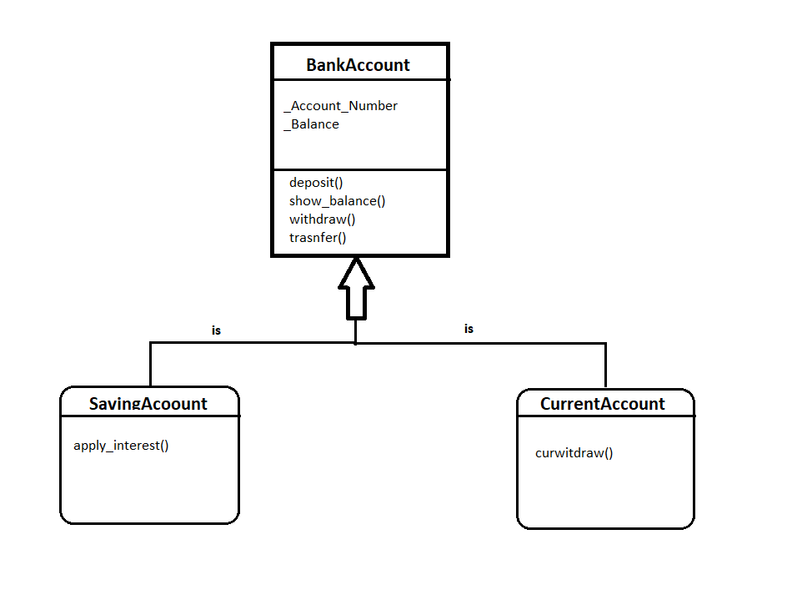
Class Design -Individual Classes

Slide 6
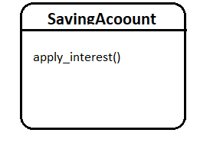
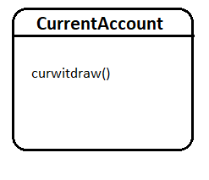
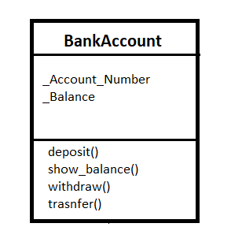

Class Design – On a Single Canvas

Slide 7
Functional Requirements of App

Slide 8
Requirement ID | Requirement CATEGORY | Requirement TYPE | PRIORITY | HIERARCHY | REF
R001 | FUNCTIONAL | STATED | HIGH
Requirement DESCRIPTION | Deposit Money
SCOPE | This method will be called or visible to deposit money.
METHODOLOGICAL DETAILS of Requirement | Deposit() method will be visible to deposit money

Slide 9
Requirement ID | Requirement CATEGORY | Requirement TYPE | PRIORITY | HIERARCHY | REF
R001 | FUNCTIONAL | STATED | HIGH
Requirement DESCRIPTION | Check Balance
SCOPE | This method will be called or visible in class object to check balance.
METHODOLOGICAL DETAILS of Requirement | Show_balance() method is used to display the balance

Slide 10
Requirement ID | Requirement CATEGORY | Requirement TYPE | PRIORITY | HIERARCHY
R001 | FUNCTIONAL | STATED | HIGH
Requirement DESCRIPTION | Withdraw
SCOPE | This method will be called or visible in class object to withdraw Money.
METHODOLOGICAL DETAILS of Requirement | Withdraw() method is used to withdrawal of money.

Slide 11
Requirement ID | Requirement CATEGORY | Requirement TYPE | PRIORITY | HIERARCHY
R001 | FUNCTIONAL | STATED | HIGH
Requirement DESCRIPTION | Transfer
SCOPE | This method will be called or visible in class object to Transfer money.
METHODOLOGICAL DETAILS of Requirement | Transfer() method is used to transfer of money.

Slide 12


OPERATING ENVIRONMENT
01
Windows
Ex-pycharm
Or
spyder
02
Mac_OS
Ex-pycharm
03
Linux
Ex-
EasyEclipse
04
Docker

Slide 13
SUMMARY OF APPLICATION
This project is a good example of object-oriented programming (OOP). The Bank_Account , Saving_Account and Current_Account classes are both objects that have their own properties and methods. The code is also modular, which makes it easy to understand and maintain.
This project is a good starting point for beginners who want to learn Python. It is relatively simple to understand and implement, but it still teaches some important OOP concepts.

Slide 14

THANK YOU
By : Avik Bhattacharyya(200636)
Smartops Fusion

